Slide 1
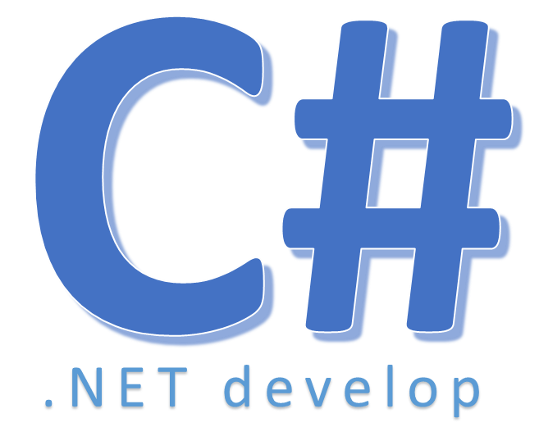

Find

Slide 2
Find
Searches for an element that matches the conditions defined by the specified predicate and returns the first occurrence within the entire Array or List

Slide 3


Hey! Coding is easy!
END

